Slide 1
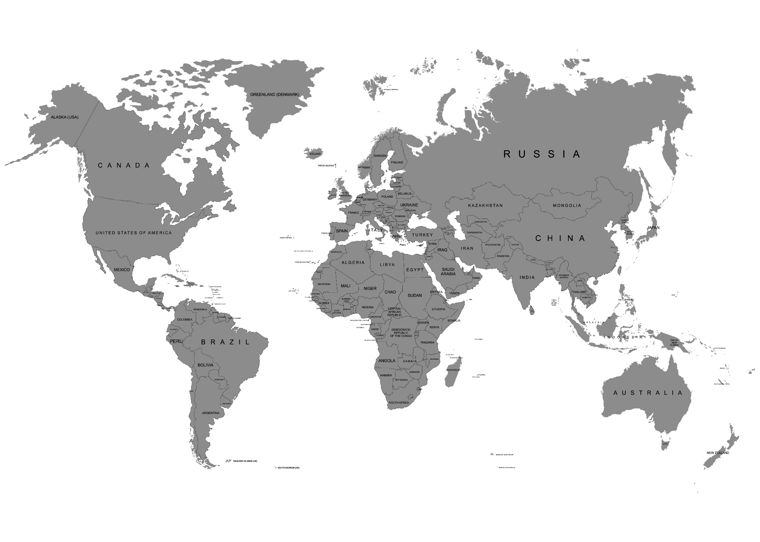






Slide 2
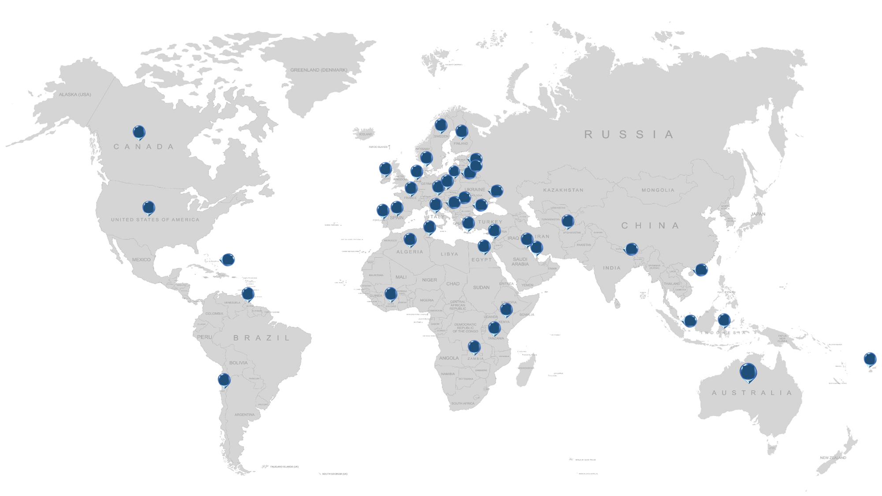


INTERPOL – NCS4
Countries Trained

